Slide 1

Password Management
By: Johnathan Hampton

Slide 2
IS their Importance in a password?
Password Management is a key aspect to not only protection of yourself but protection of your organization.

Slide 3
What is a password?
Creating and managing passwords to be as secure as possible
Credentials for password include:
- Alphabetic Characters, Numbers, and Symbols
Strong Passwords Weak Passwords
Characteristics
Personalization Common Mistakes
Highly recommended 12 characters or more “password”
Shouldn’t contain words in the dictionary short passwords

Slide 4
Why you need a secure password?
Guessing:
Method of gaining access to an account by attempting to authenticate the user
Brute Force – using every possible combination of characters for access
Dictionary Attack -
Social Engineering
Deceiving users into revealing their username and password
How they do it?
Pretending to be an IT employee or gain trust through personalization
Never share passwords to anyone this is personal information and should be treated as so

Slide 5
How Many passwords do you have?

Slide 6
Tiered Password System Different Levels of Passwords
Low Security
- This is the easiest secured password for newsletter, and opportunities
Medium Security
- The second layer closest to the most secure level of password. Examples include open sites and email services.
High Security
- The last layer is the highest level of security used for financing and personal assets

Slide 7
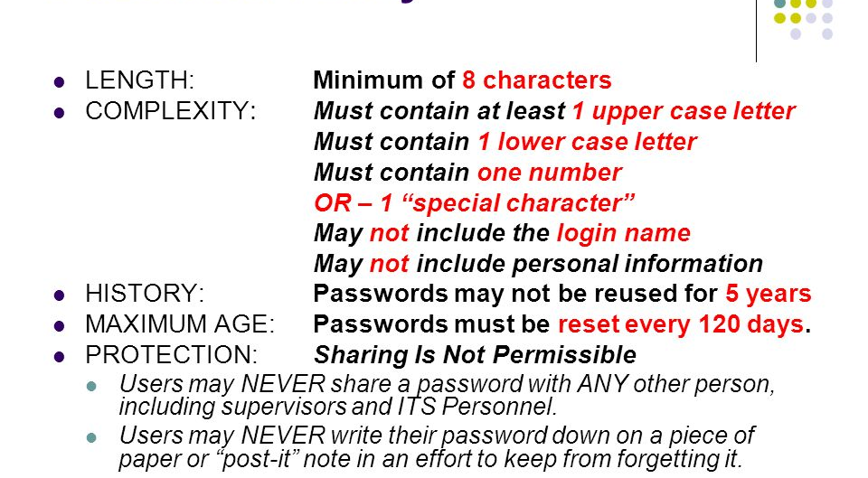

Slide 8
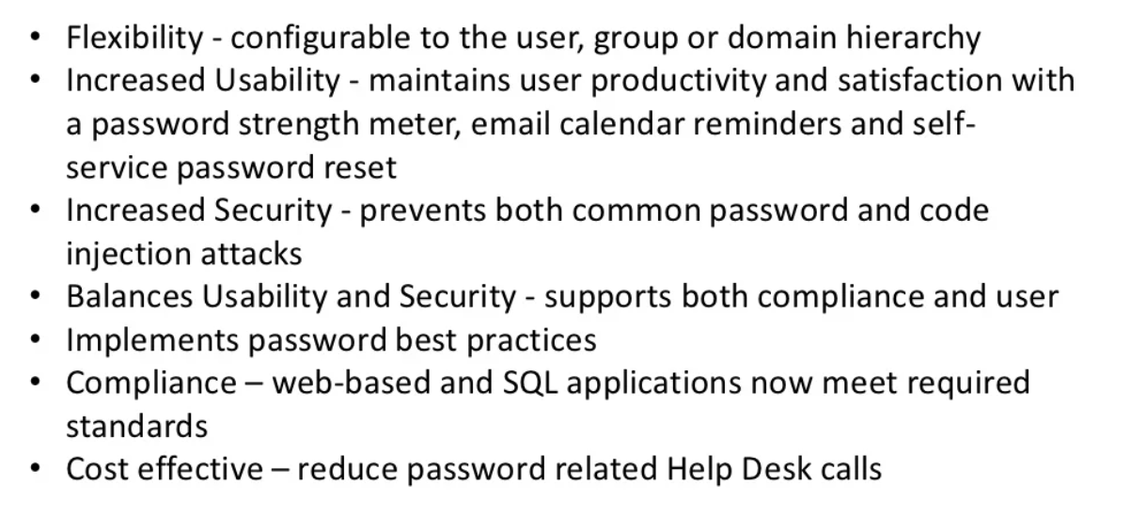
Benefits

Slide 9
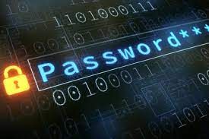

Slide 10
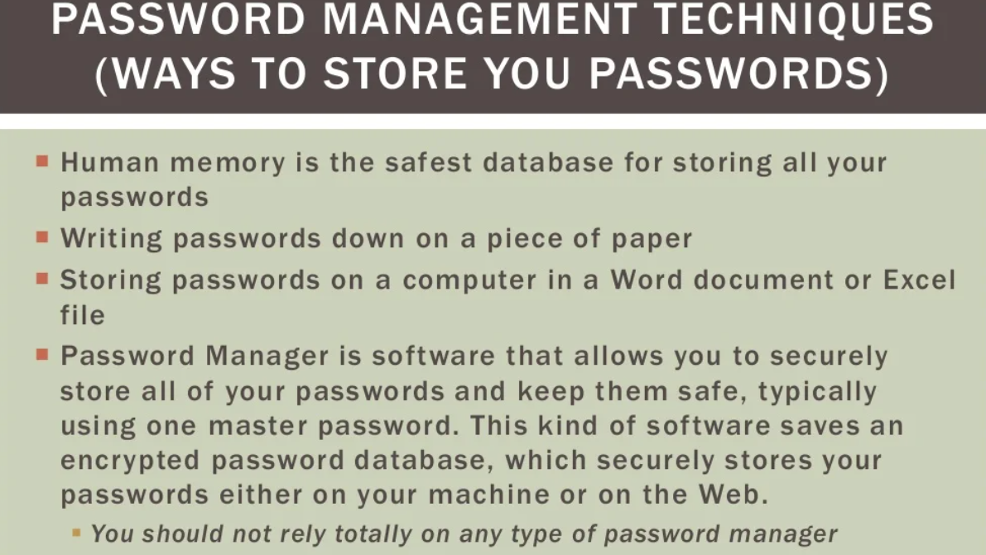

Slide 11
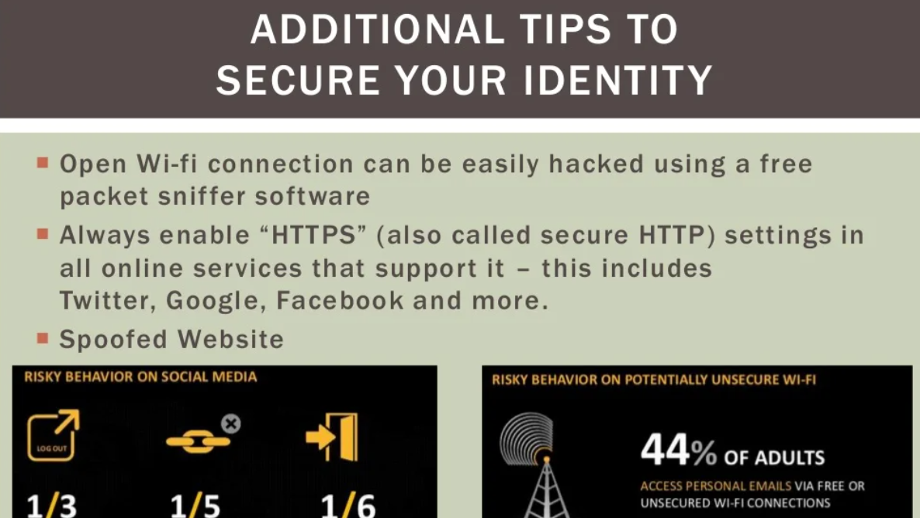

Slide 12

The END

